Slide 1
Origins of Data, Computing Lines, Curves, and Numbers
Dr. Charles R. Severance
www.ca4e.com
online.dr-chuck.com

Slide 2
Outline
Solar System
Stonehenge / Sun Dial
Continuous physical analog computing
Ankithera / Planet Mobile / Slide Rule / Pilot E6B
Digital physical devices
Pen / Clocks / Adders / Multipliers
CRC Standard Mathematical Tables
More complex mathematical functions without calculator
Iteration
"Human Computers" / Babbage Difference Engine
Electromechanical Computers
Bomba / Pinball Machine
Electronic Computers – Tubes
Colossus

Slide 3
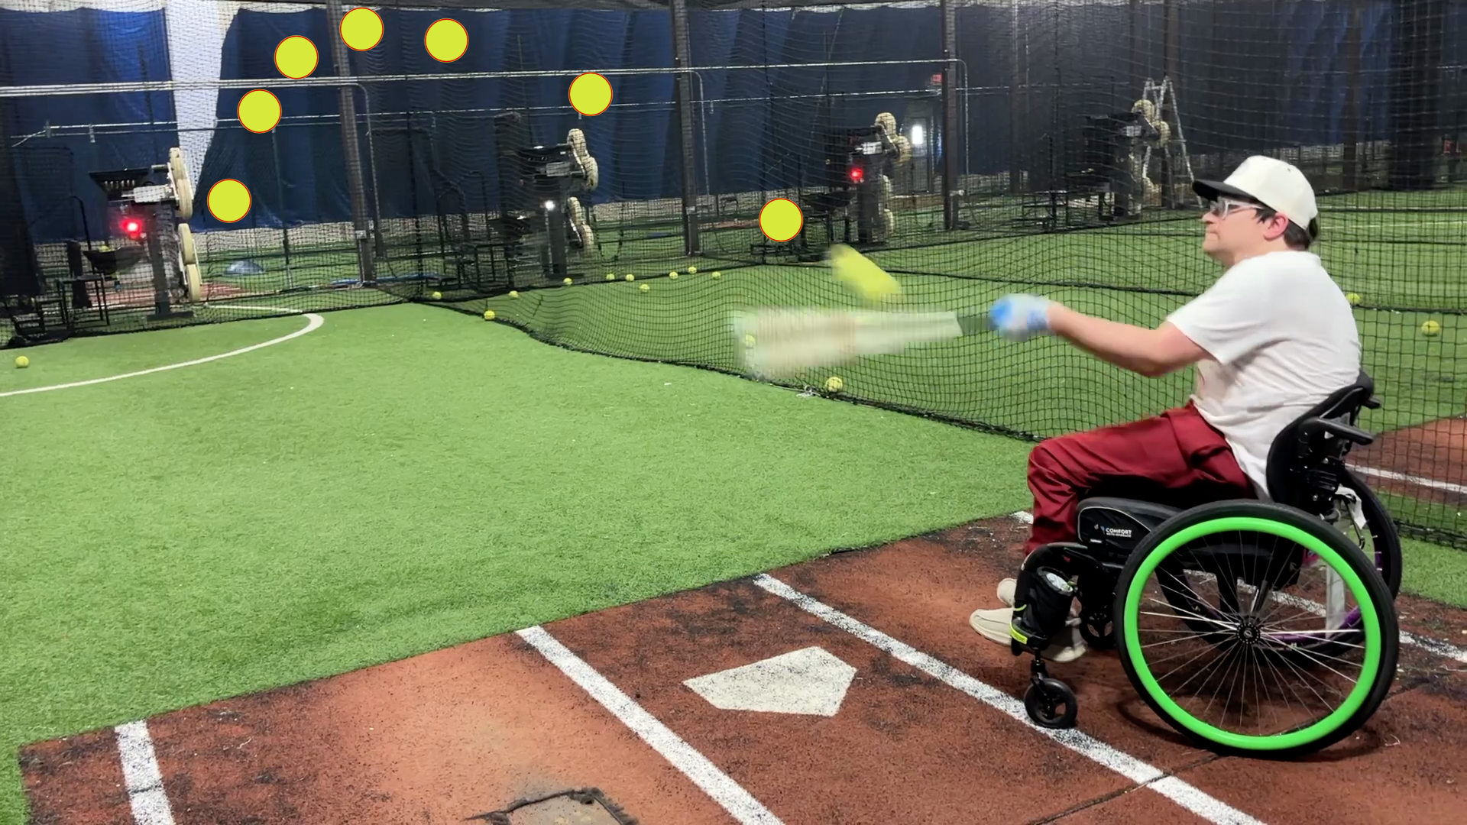
Our eyes "see" objects in a straight line from our eye to the object. But in nature, any moving object is moving along a curve. Predicting the path of a moving object requires a lot of measuring, analysis, and mathematics. Our brains understand (or have been programmed to understand) curved motion implicitly. Predicting the path of a moving object in three dimensions is necessary for us to survive (and play sports)
Photo Courtesy of @WarWheelz

Slide 4
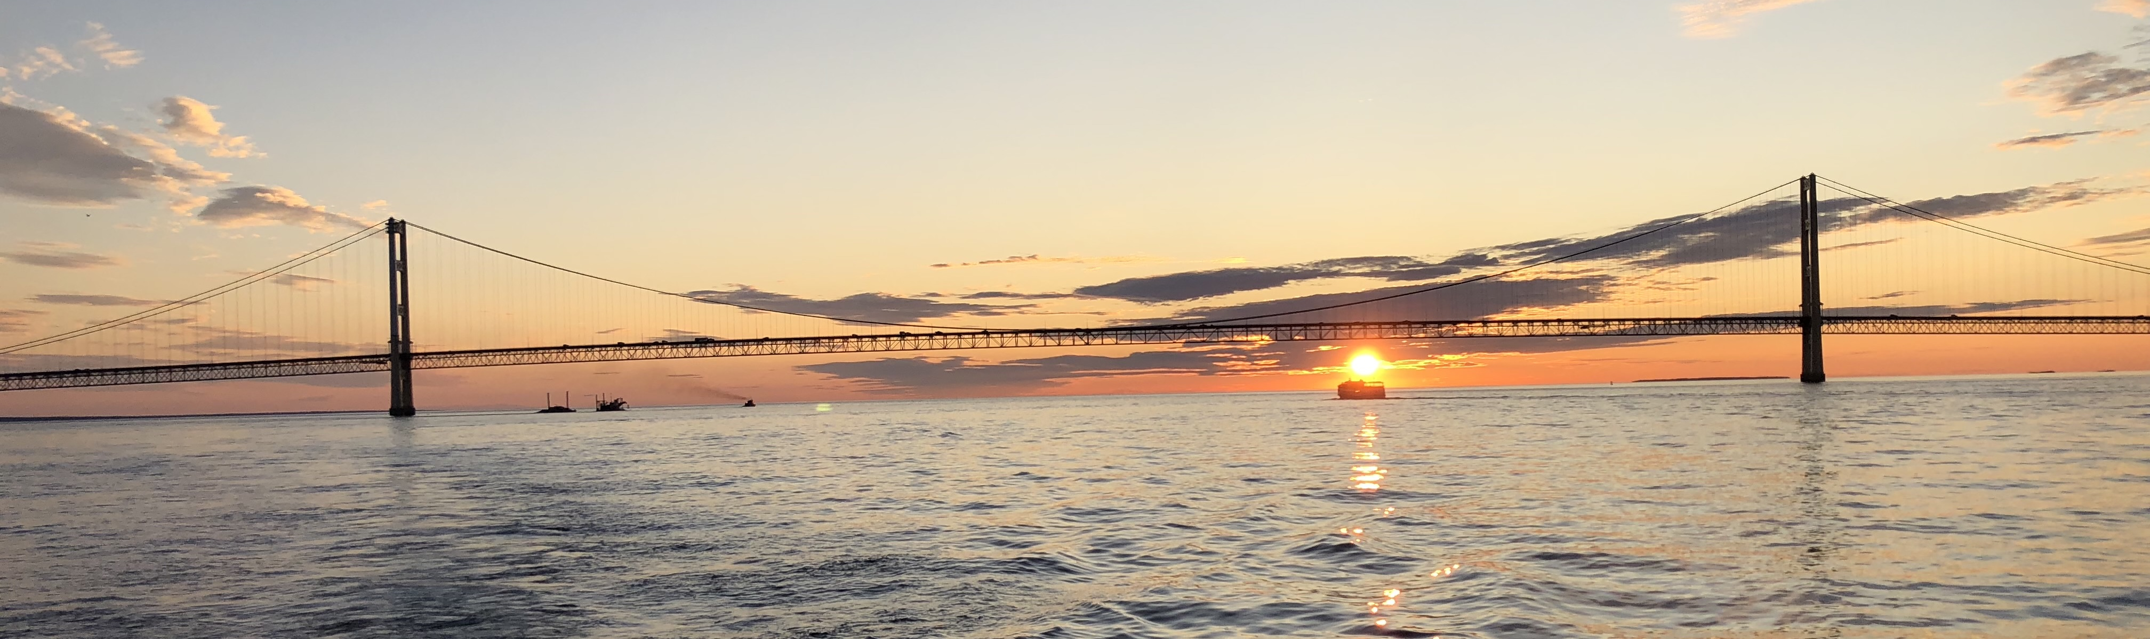
Astronomy – Star Gazing
Amateur scientists from the beginning of human consciousness have stared at the Sun, Moon, Planets, and Stars and tried to gain insight
December
March
June
November
August
December
September
June

Slide 5
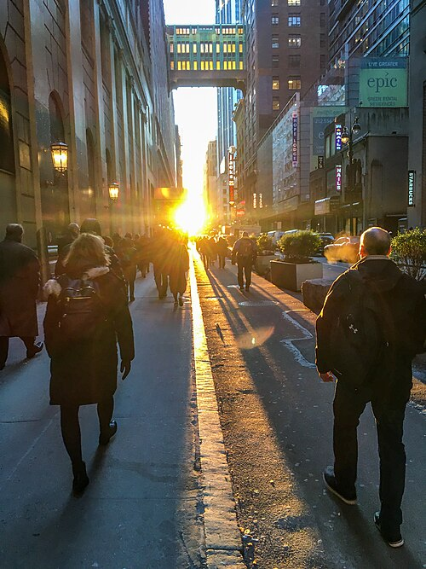
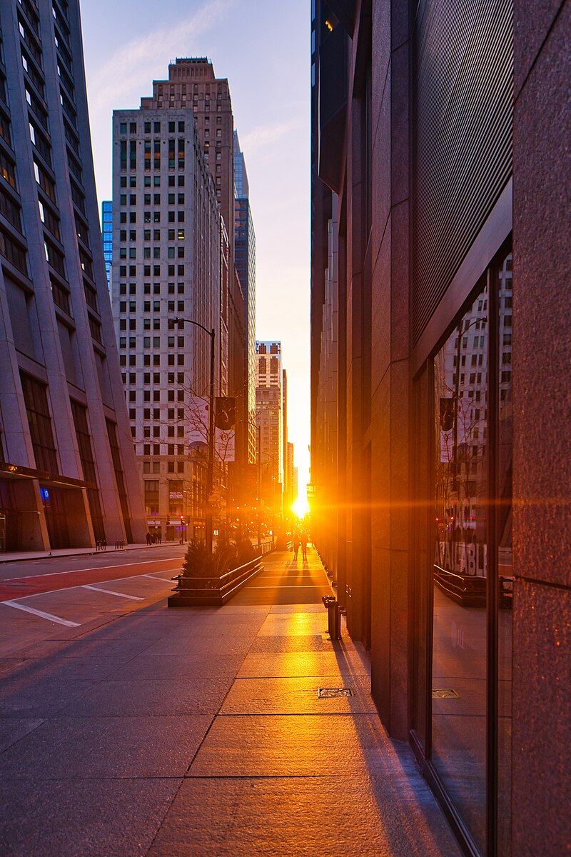
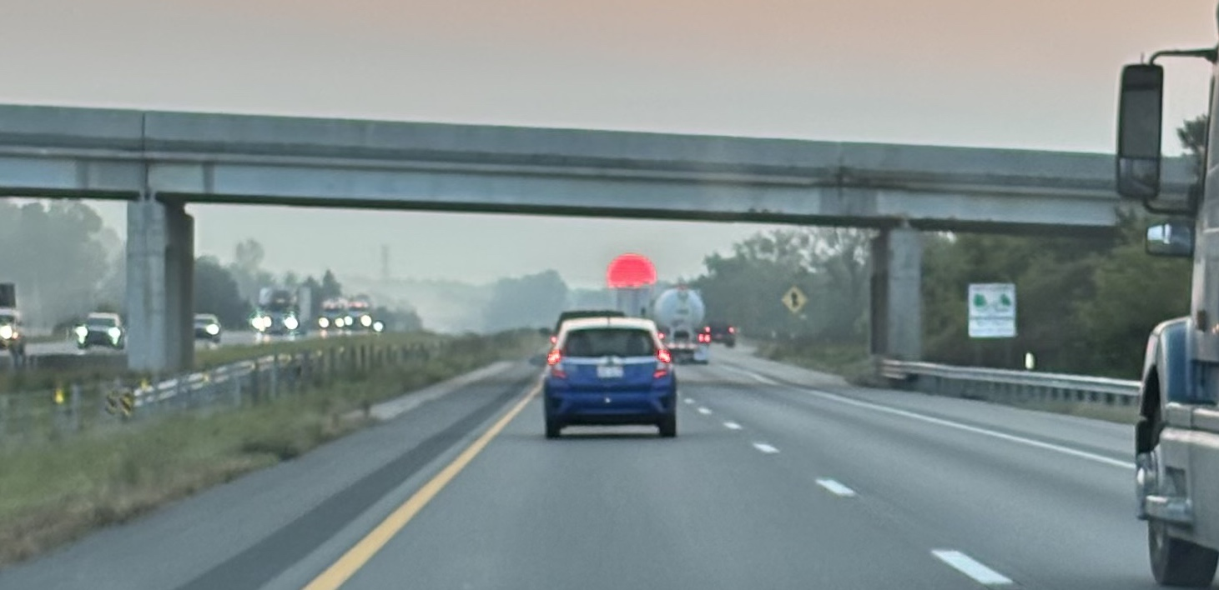
Stone Henge – 4500 Years Ago (YA)
AI: Ancient artifacts to measure the Sun around the world
Gobekli Tepe, Turkey Lunar / Solar Calendar (?) – 13000YA
Egypt Sun dials invented 3500 years ago (YA)
China sun dials over 3000 YA
Mexico The Descent of Kukulkán – 1200 YA
Temple of Petra 1000 YA
India Sun Temple, Konârak – 750 YA
Modern Henges
Manhattan Henge 2020-01
Chicago henge 2022-03
Dr. Chuck's commute henge 2024-09
Photos from Wikipedia.

Slide 6
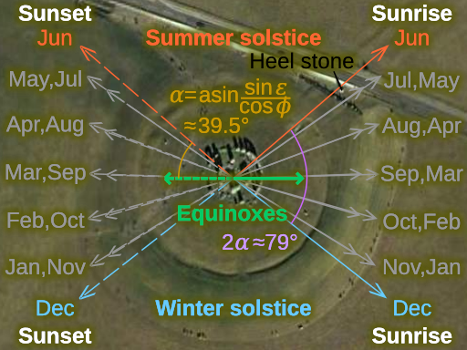
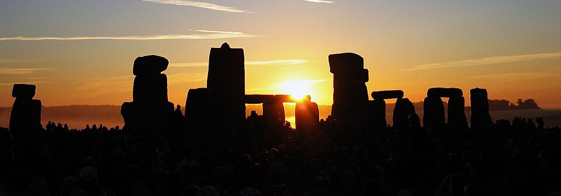
Stonehenge: Sunrise and sunset tracking
Stonehenge had several versions and was built iteratively from 5100 YA to 3600 YA (Years ago)
By the time the center structure was built, the earlier structures carefully measured the angle of sunrise and sunset throughout the year
You can think of it as a sun tracking data table calibrated over 2500 years

Slide 7
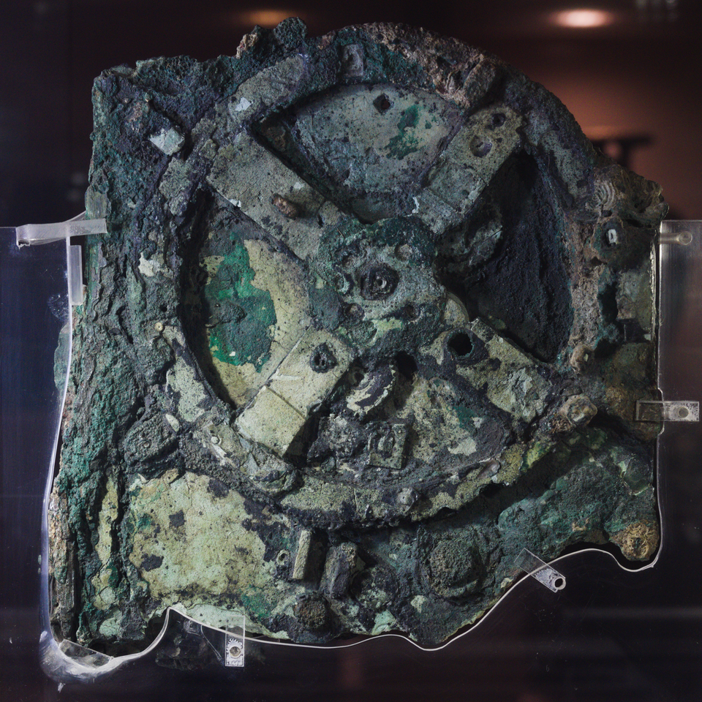

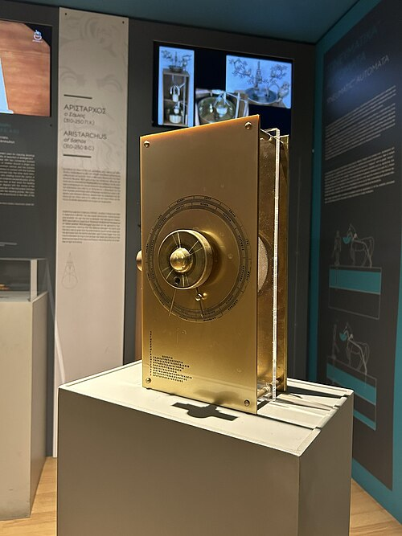
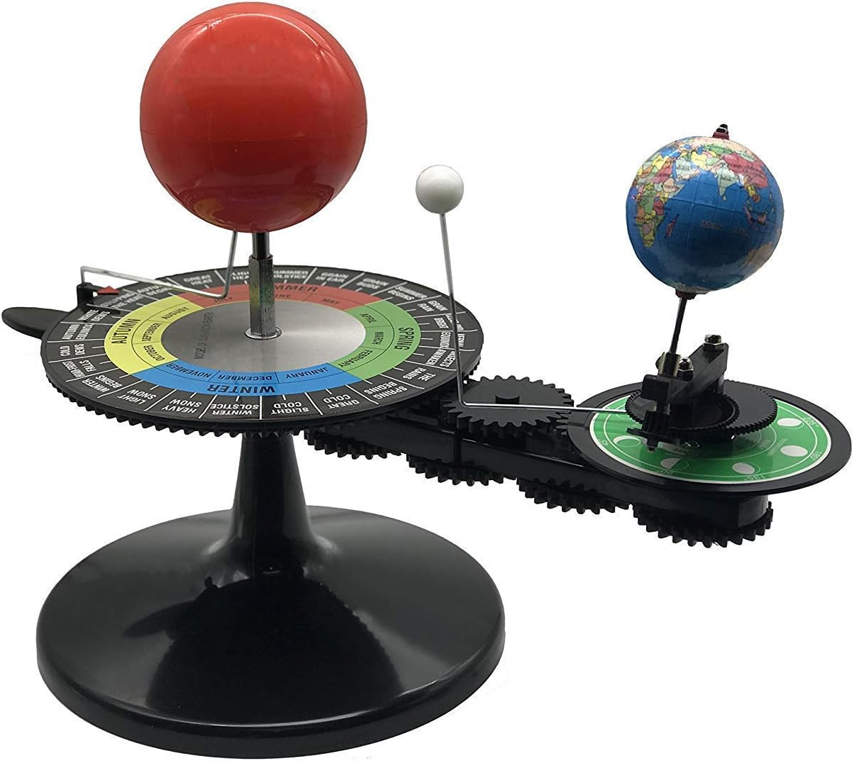
Antikythera mechanism – 2100 YA
Oldest known contiuous analogue computer
Uses gears to model the known solar system
Sun, Moon, Earth, Mercury, Venue, Mars, Jupiter, Saturn
Models more complex Sun-Moon-Earth 19, 76 and 223 year cycles
Indiana Jones and The Dial of Destiny
You can buy one on Amazon
AI: Antikithera like mechanisms in cultures around the world

Slide 8
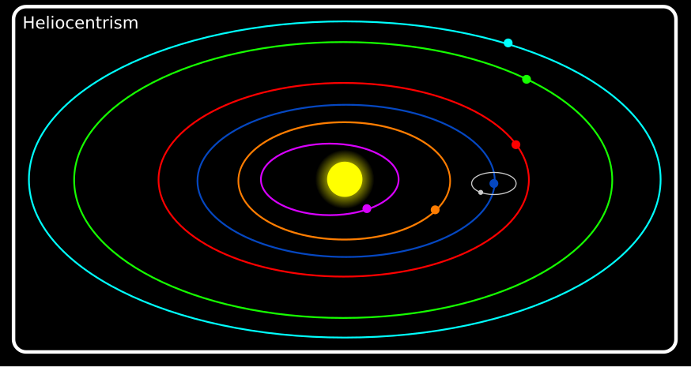
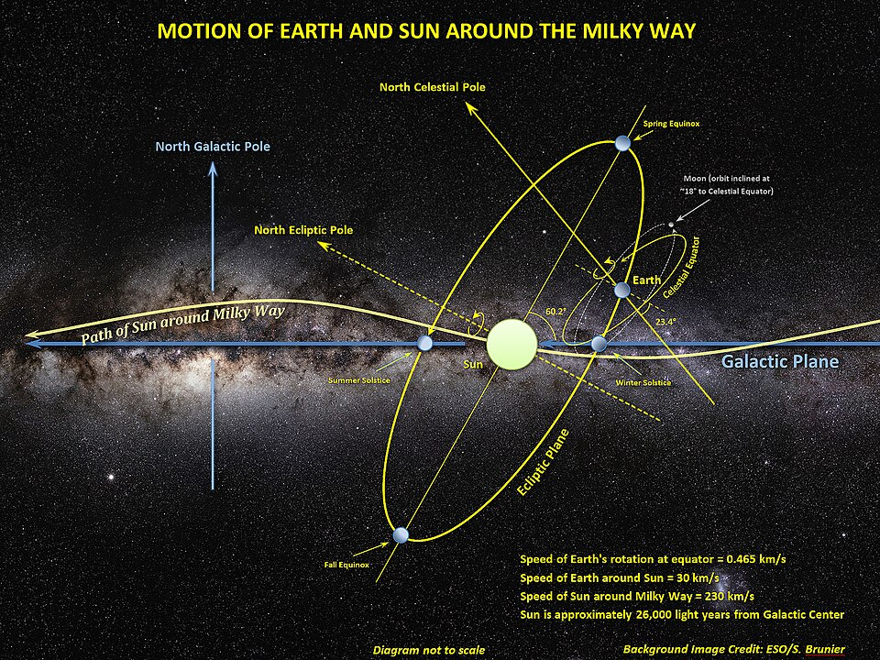
Reflections on Solar System Models
www.ca4e.com/ref
We have been taught a simple model of the solar system called "helio-centrism" conceived by Nicolaus Copernicus in 1543
But the planets are at different angles and the sun is also moving
Earth moves in a spinning moving vortex chasing the sun through the Milky Way
AI: Actual motion of earth through the milky way galaxy
AI: Nicolaus Copernicus gets in trouble
Notes:
www.youtube.com/watch?v=fJuaPyQFrYk

Slide 9
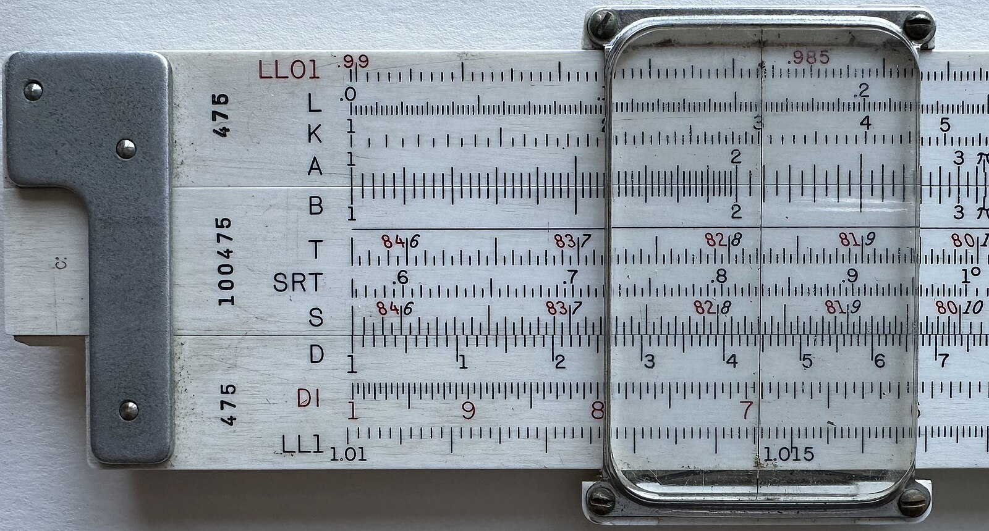
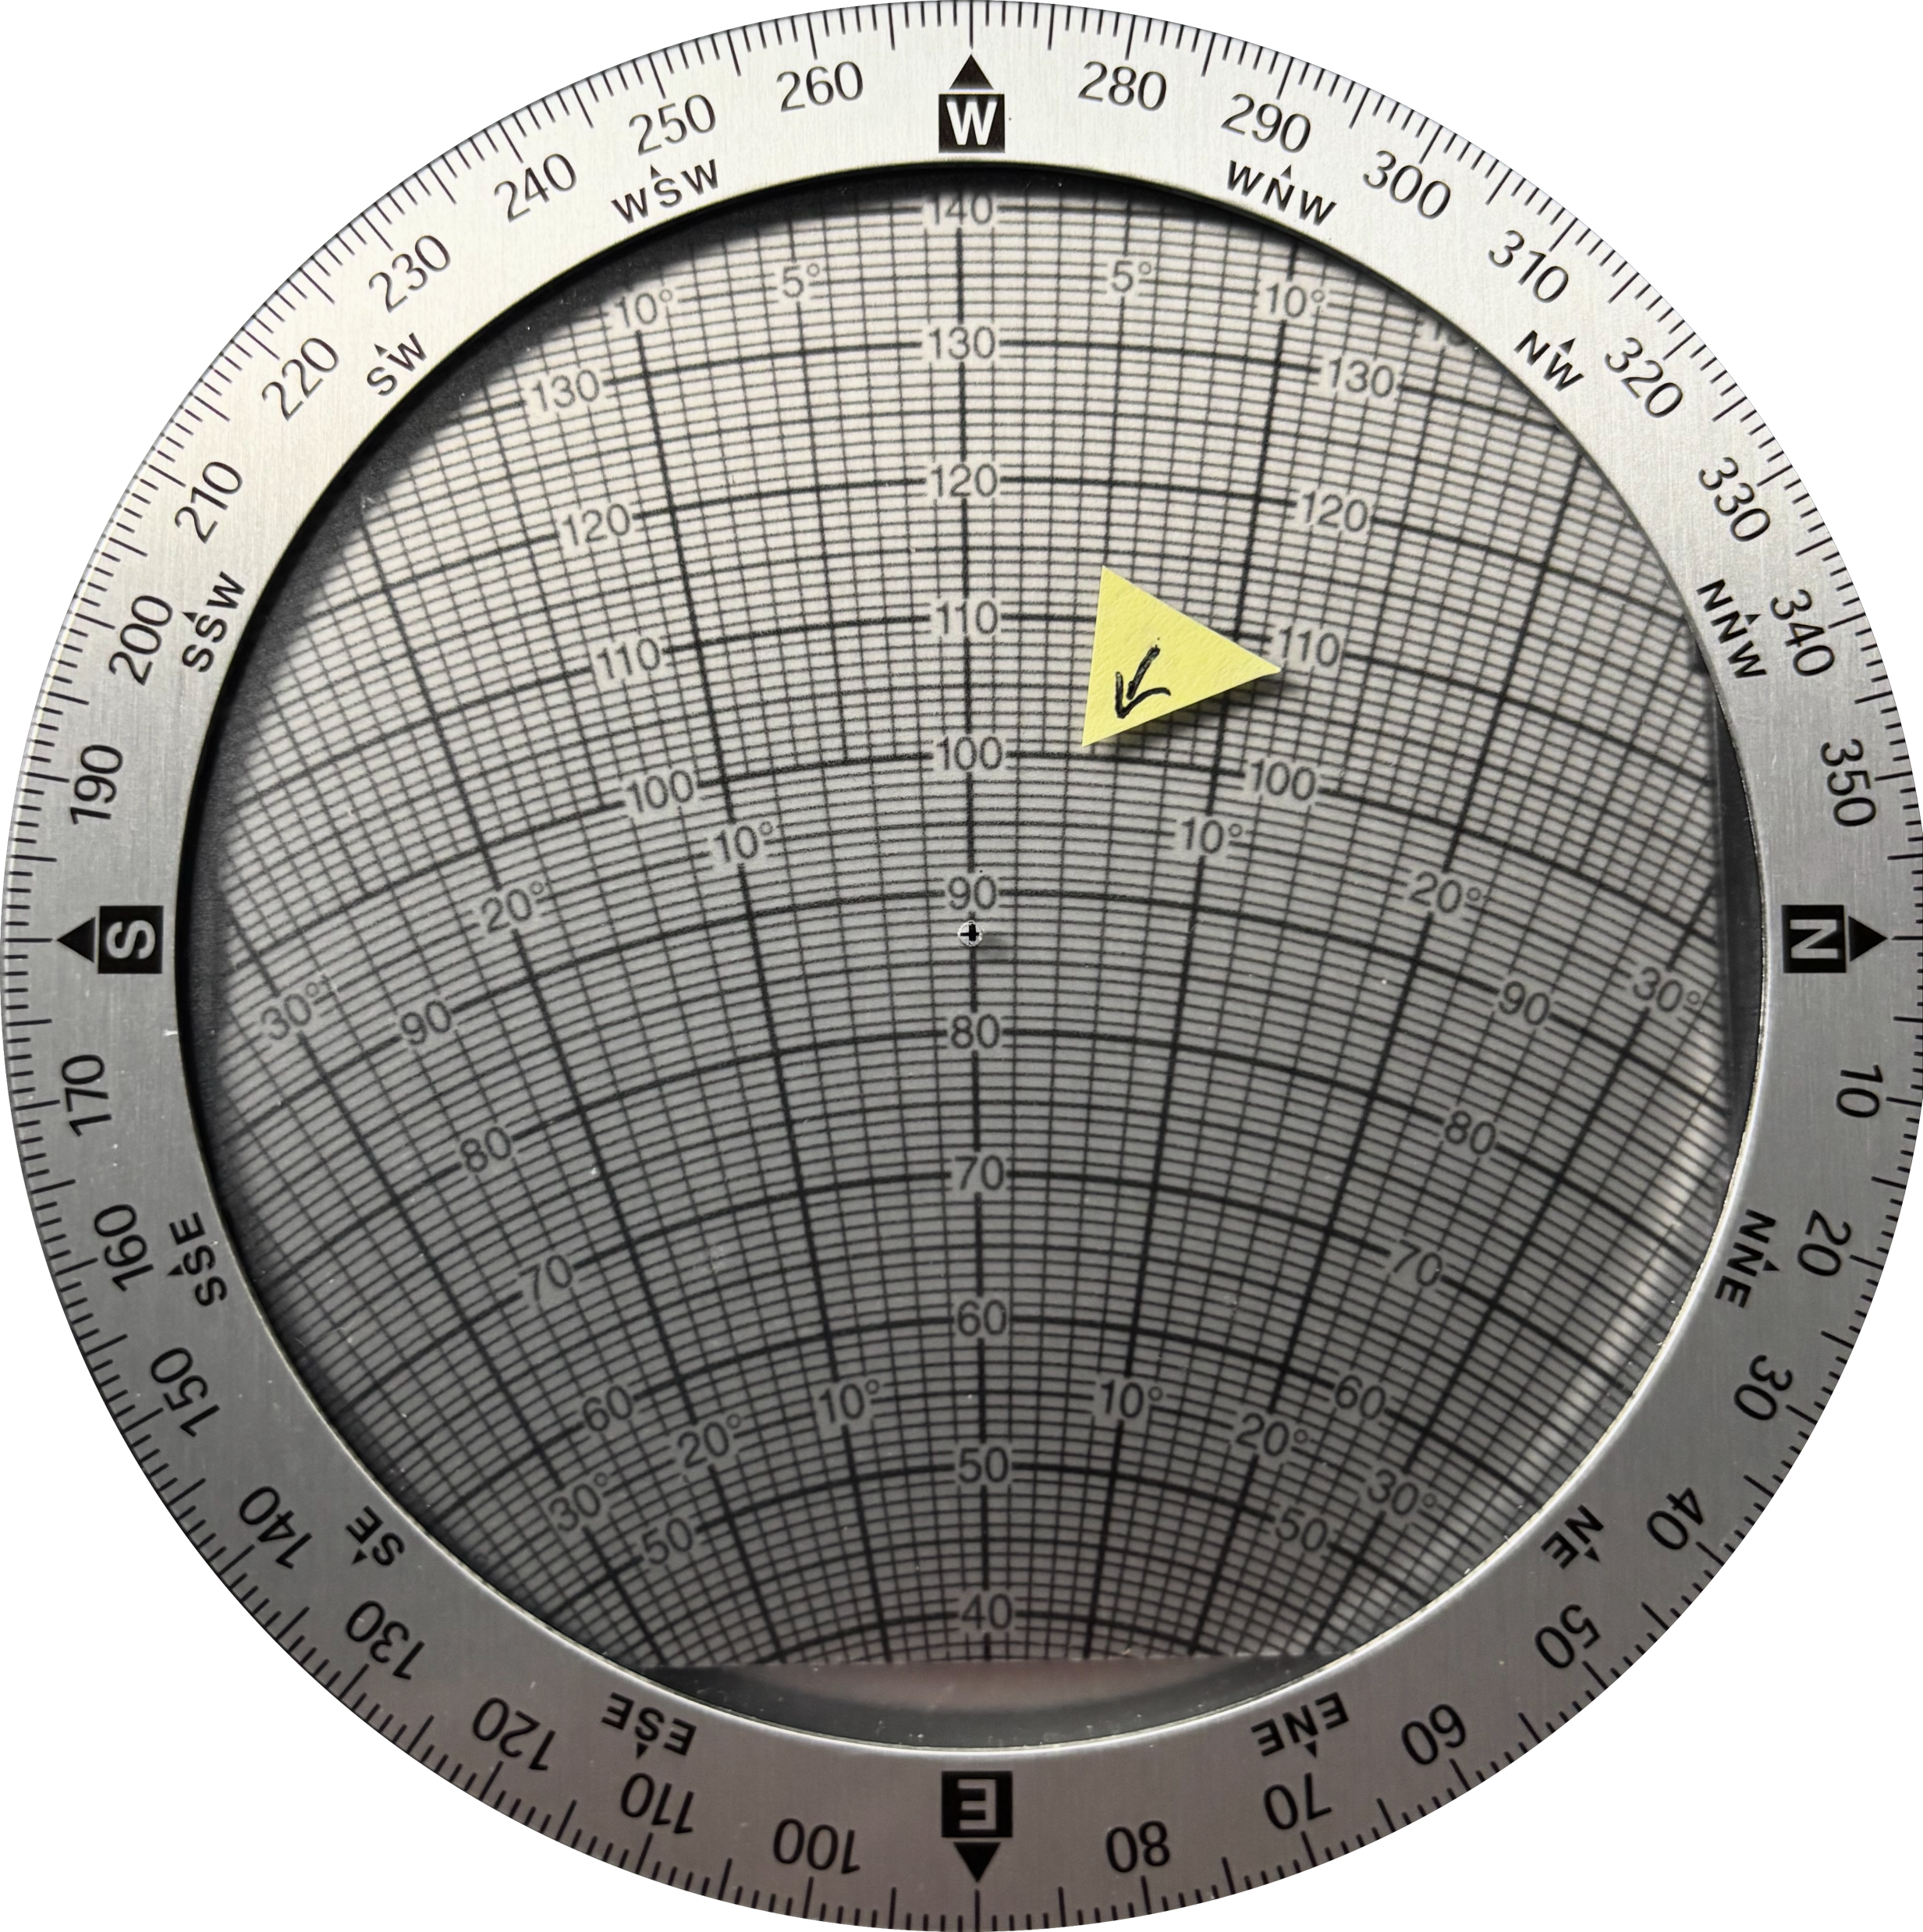
Modern Continuous Analog Computing Devices
Slide Rule – Multiplication using addition and logarithms
E6B wind calculator for airplane pilots that uses a circular calculator to do trigonometry and Pythagorean theorem computations
https://commons.wikimedia.org/wiki/File:Slide_rule_scales_front.jpg

Slide 10
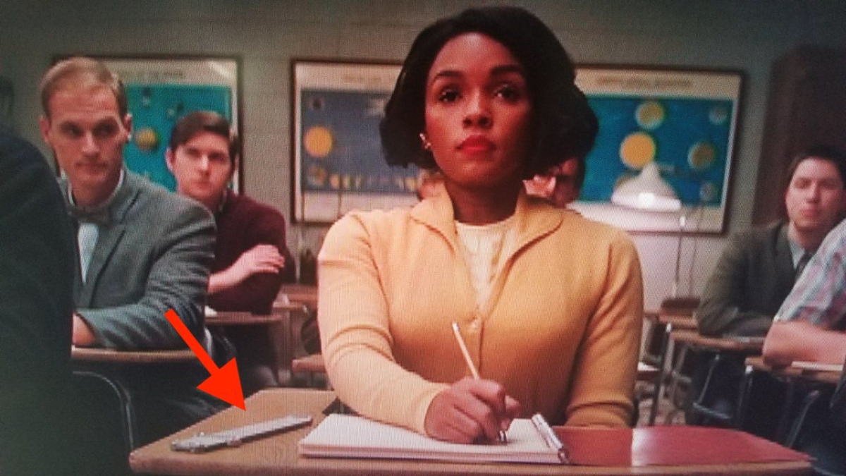
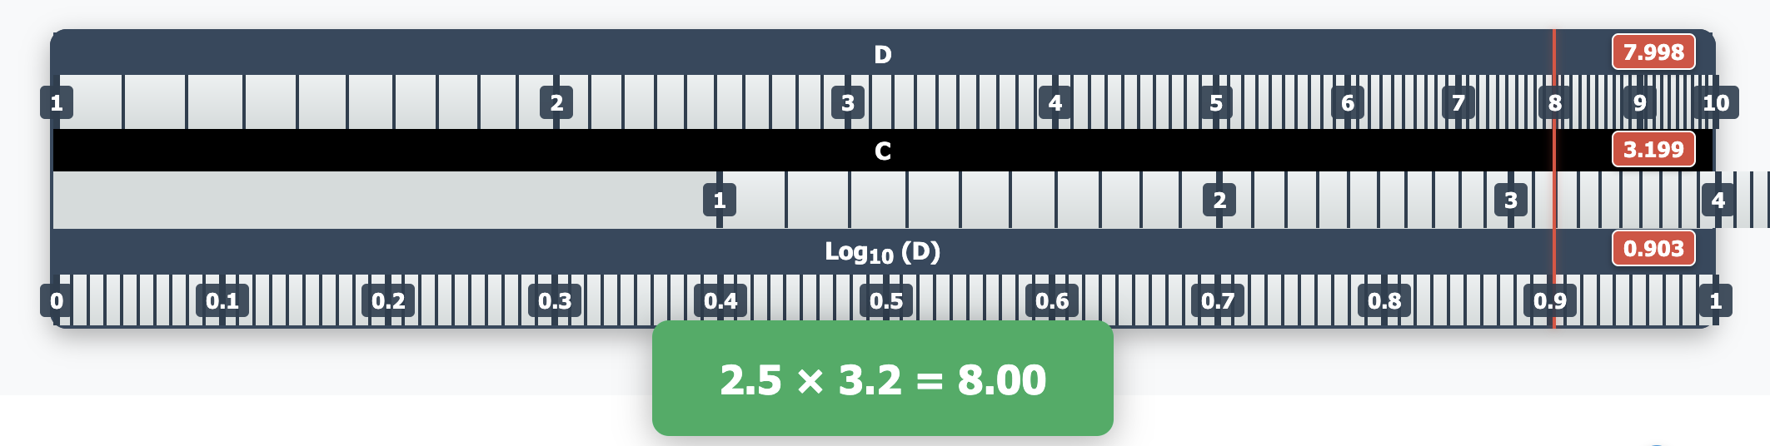
Slide Rule
www.ca4e.com/ref
Screen shot from Hidden Figures movie
https://commons.wikimedia.org/wiki/File:Slide_rule_scales_front.jpg

Slide 11
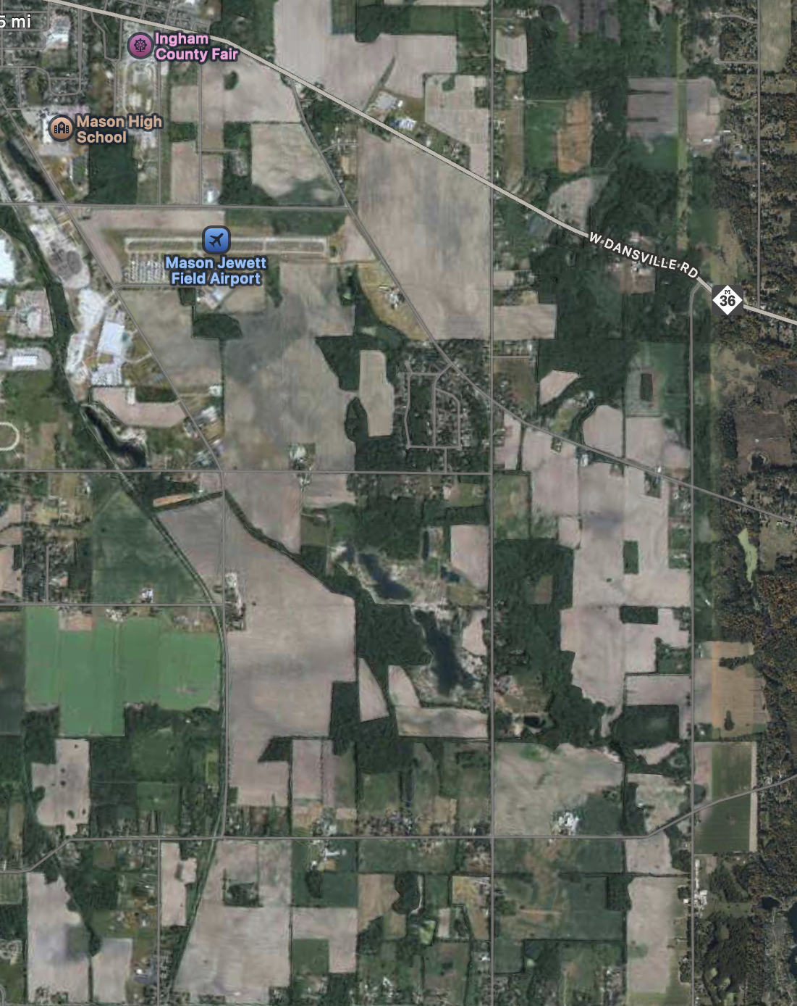
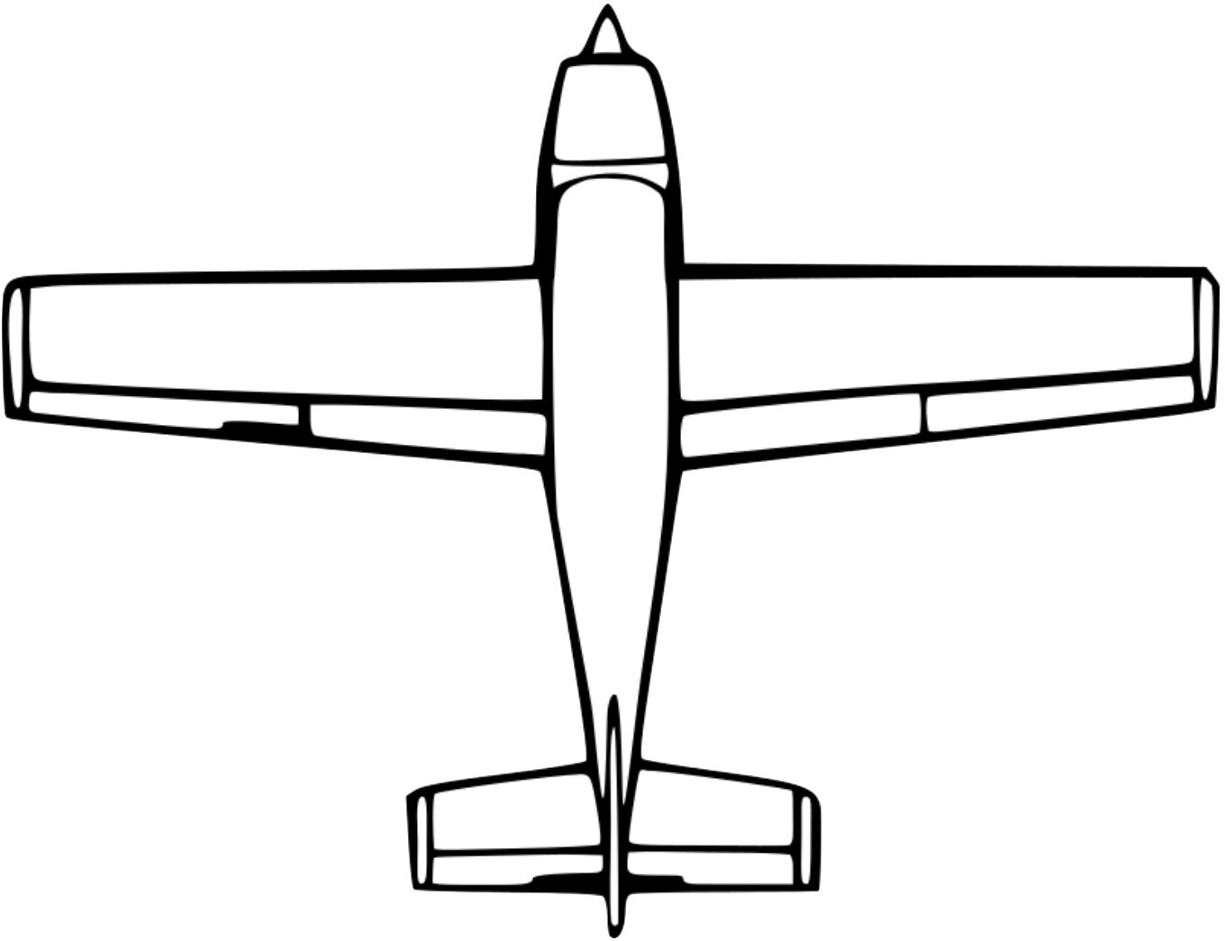
Computing Wind Correction for Airplanes (drift angle)
Our airplane goes 100 miles per hour and we want to go west (270 degrees)
The wind is out of the northwest (300 degrees) at 15 miles per hour
If we fly straight west, the wind will both slow us down and push us south
Where should we point the plane to actually go west and what is our effective ground speed?

Slide 12
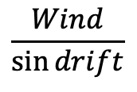
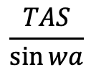
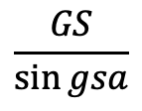
Use Law of Sines!
wa
WIND
www.ca4e.com/ref
WIND
WIND
gsa
wa
gsa
gsa
wa
GS
GS
TAS
GS
TAS
TAS
$$\frac{TAS}{\sin{wa}}$$
=
$$\frac{Wind}{\sin{drift}}$$
=
$$\frac{GS}{\sin{gsa}}$$
drift
drift
drift
# Python:
drift = math.degrees(math.asin(math.sin(math.radians(wa)) / tas * wind))
gsa = 180 - ((wa % 180) + drift)
gs = math.fabs((wind * math.sin(math.radians(gsa))) / math.sin(math.radians(drift)))

Slide 13
To *actually* go west…
Our airplane goes 100 miles per hour and we want to go west (270 degrees)
The wind is out of the northwest (300 degrees) at 15 miles per hour
We will fly a heading of 274.3 degrees and expect a ground speed (west) of 87 miles per hour

Slide 14
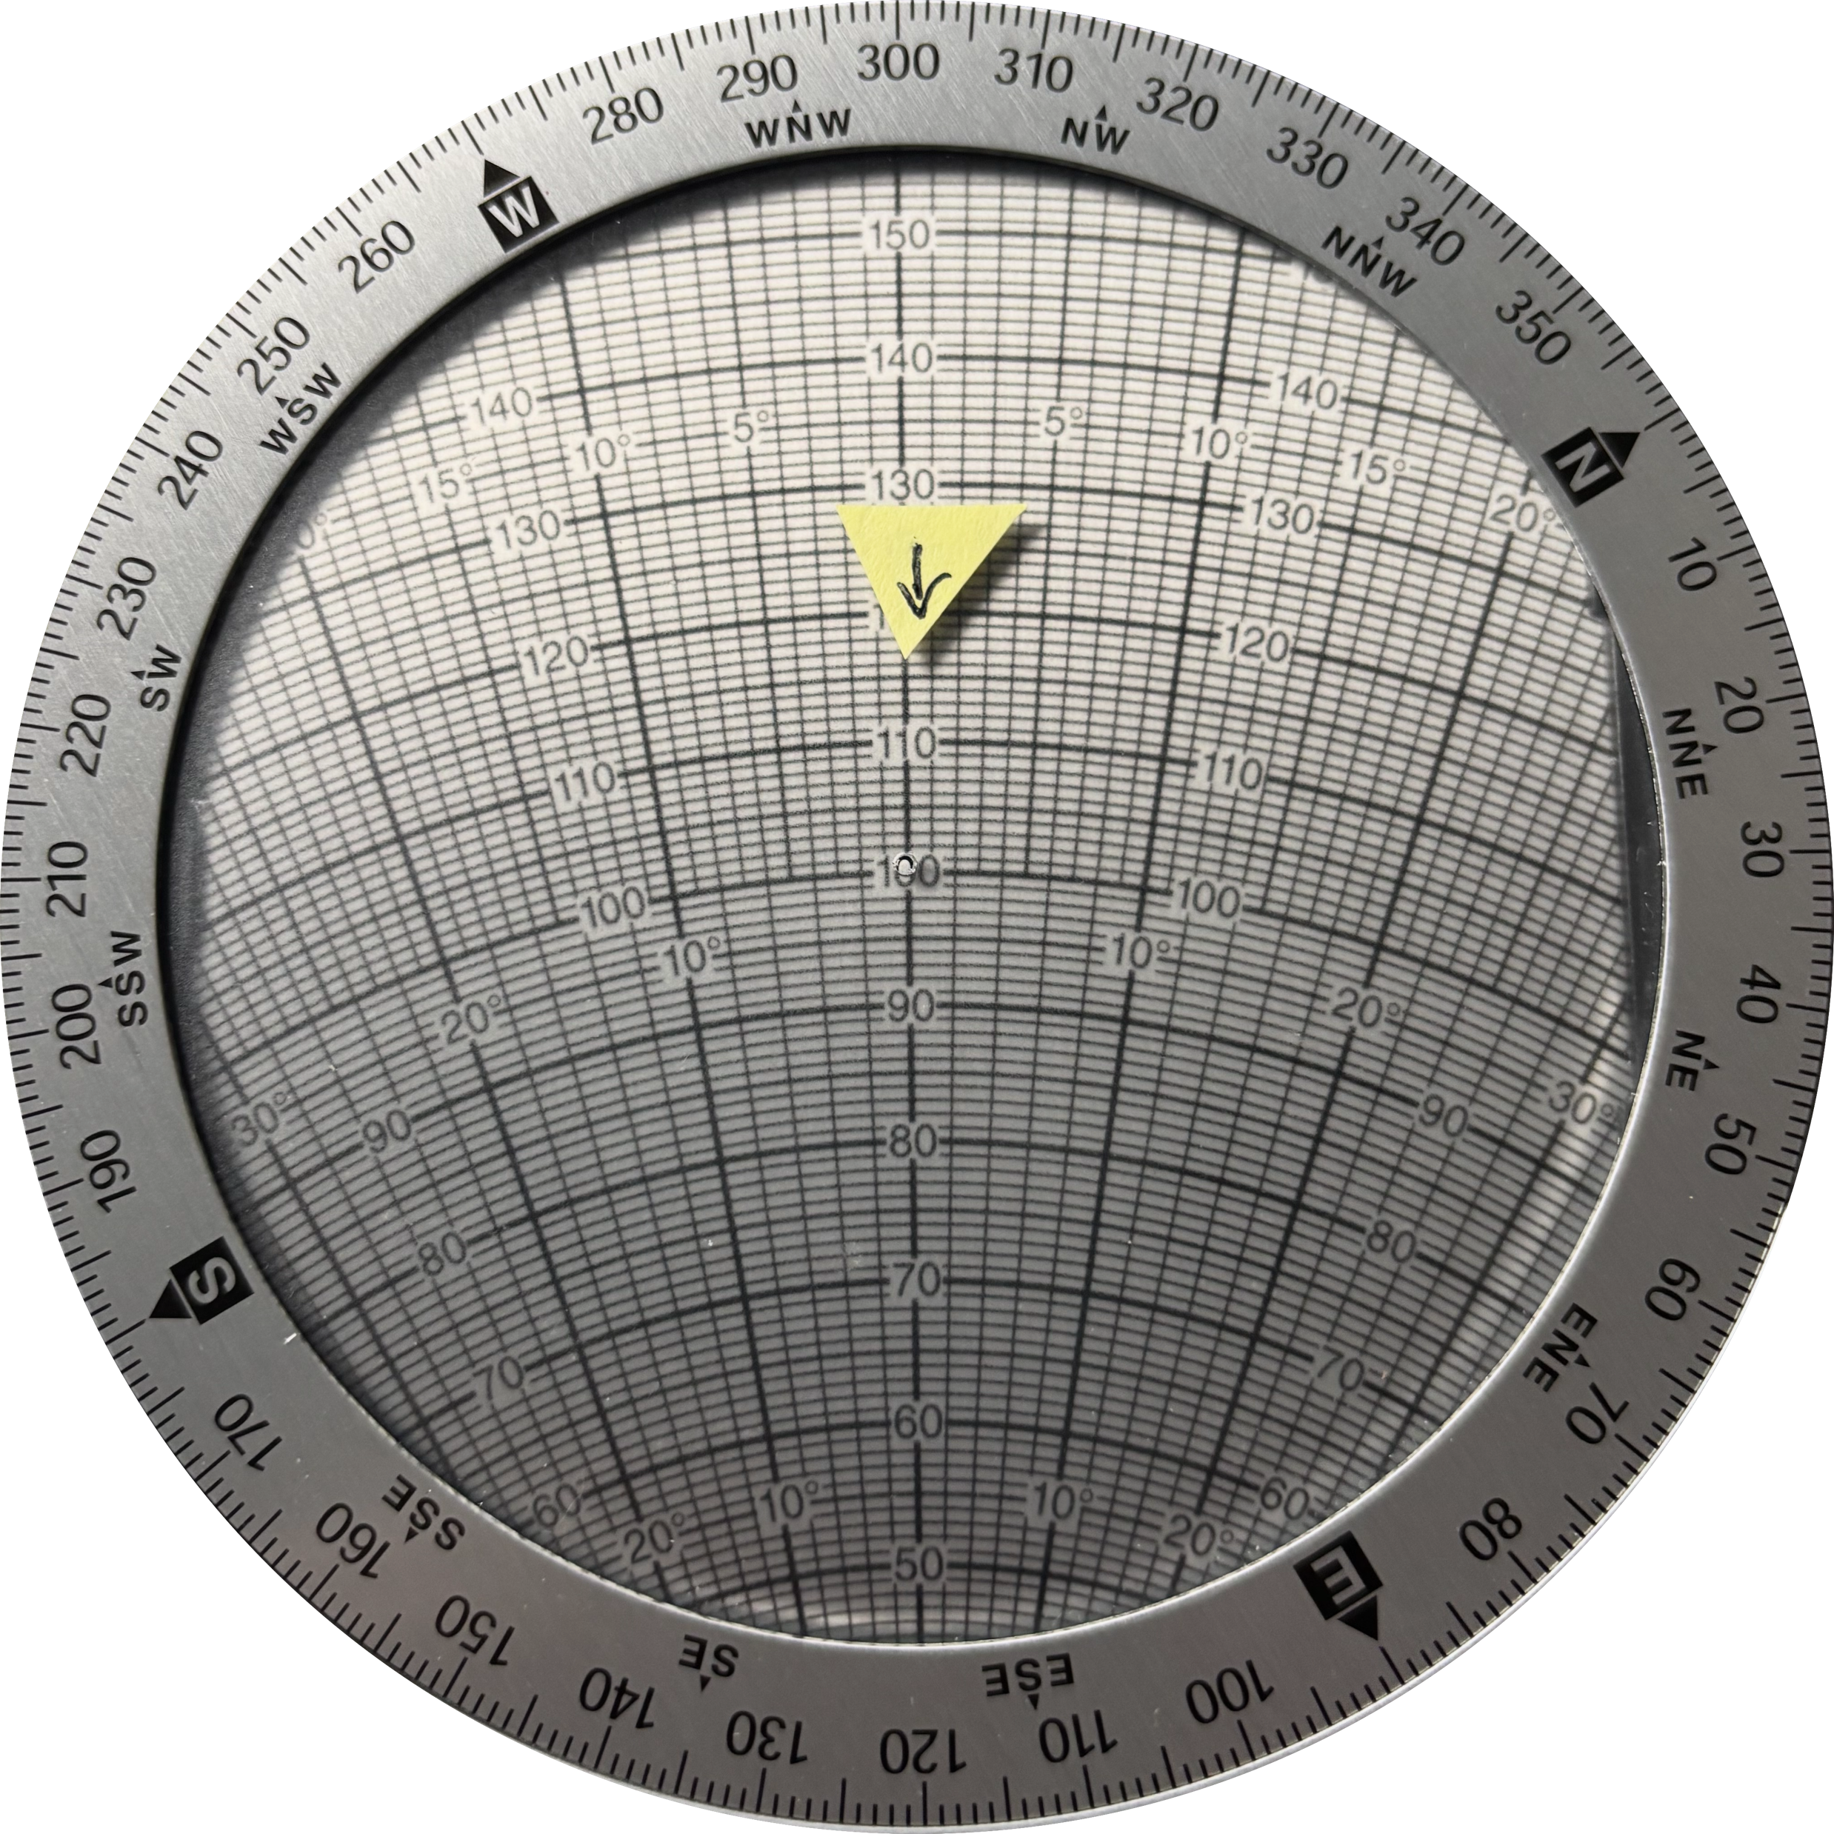
Pilots and Trigonomerty?
Set Wind Direction
Set Wind Speed
We have an analog computer called the E6B that does the entire calculation by rotating and sliding and reading numbers directly from the device
This is an analogue equivalent to the trigonometric computation
Rotate to true course
Slide to air speed
Read drift angle
Read ground speed

Slide 15
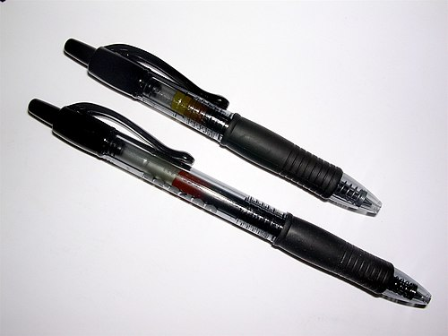
Physical devices that are digital
Physically built to have two stable states
On (1) or Off (0)
Require sufficient physical input to switch states – you often hear a click
If the input is not enough to change state they usually fall back to the previous stable state
Capturing the new state is often called "latching" – it sounds a bit like clicking
https://en.wikipedia.org/wiki/Retractable_pen

Slide 16
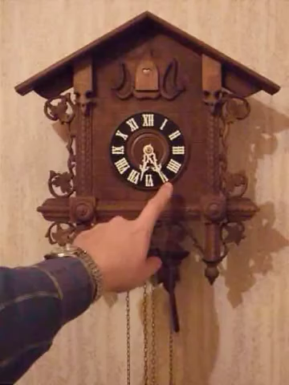
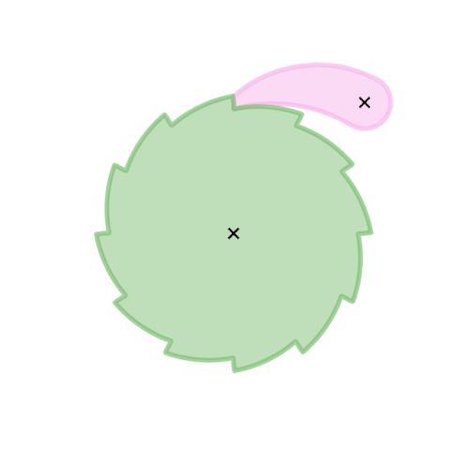
Clocks as Counters
Early clocks used a pendulum and a series of rachets and gears that acted as counters for seconds, minutes, and hours
At particular times / counts they would run "programs" to make sounds to mark the passage of time
https://en.wikipedia.org/wiki/Ratchet_(device)
https://en.wikipedia.org/wiki/Cuckoo_clock

Slide 17
Counters with Carry Propagation
Numbers with multiple columns can be added if there is a carry mechanism that advaces the nex

Slide 18
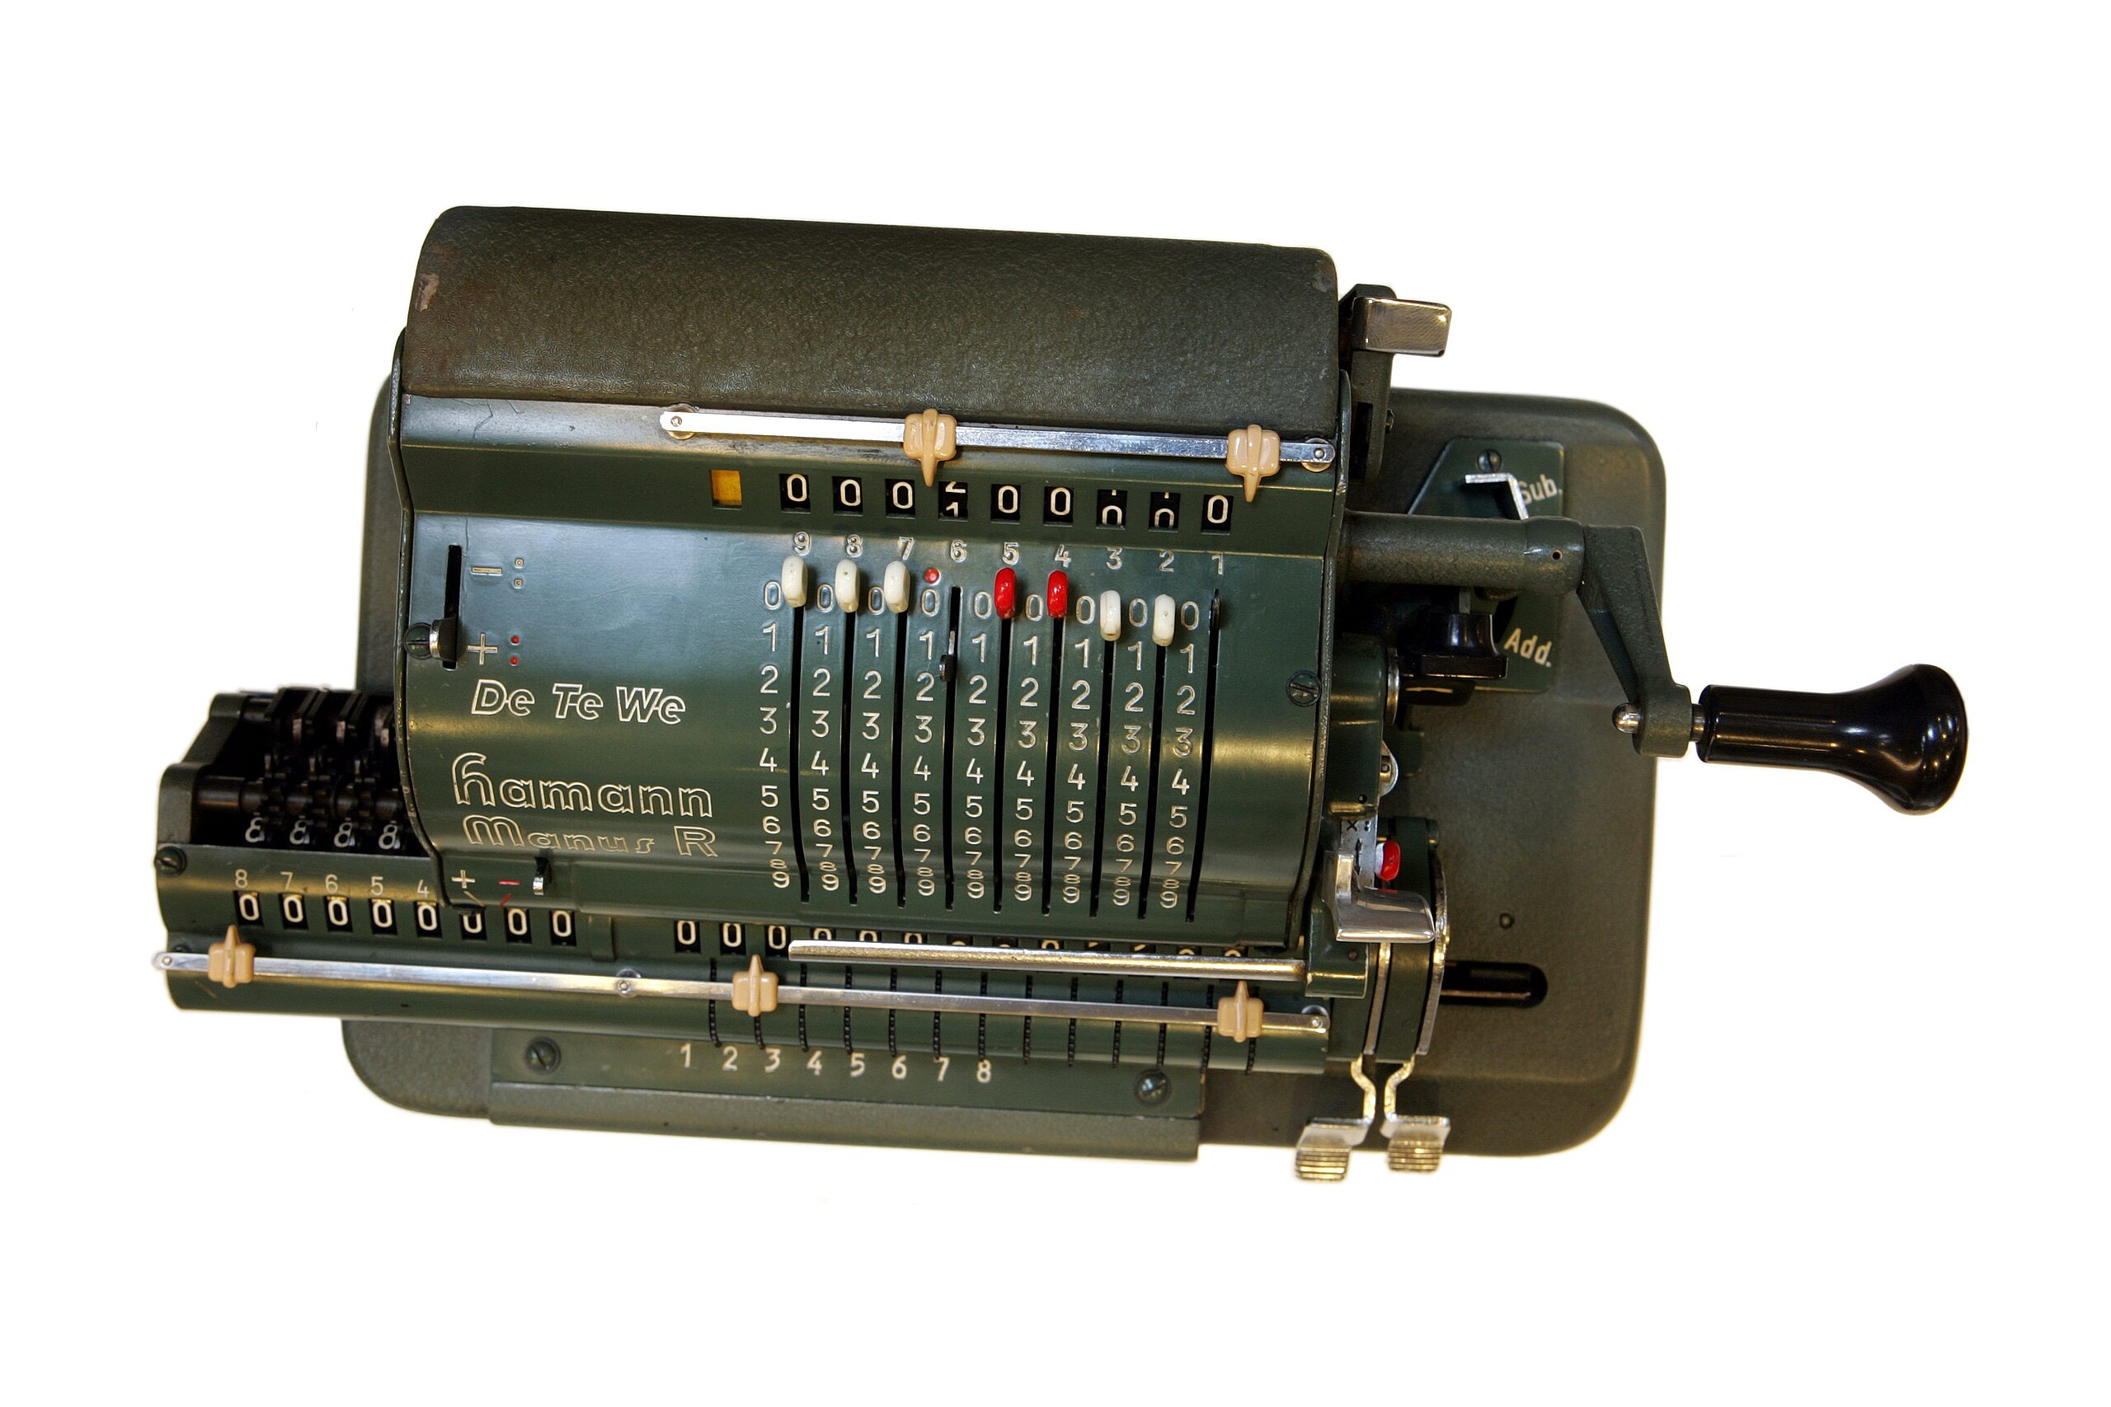
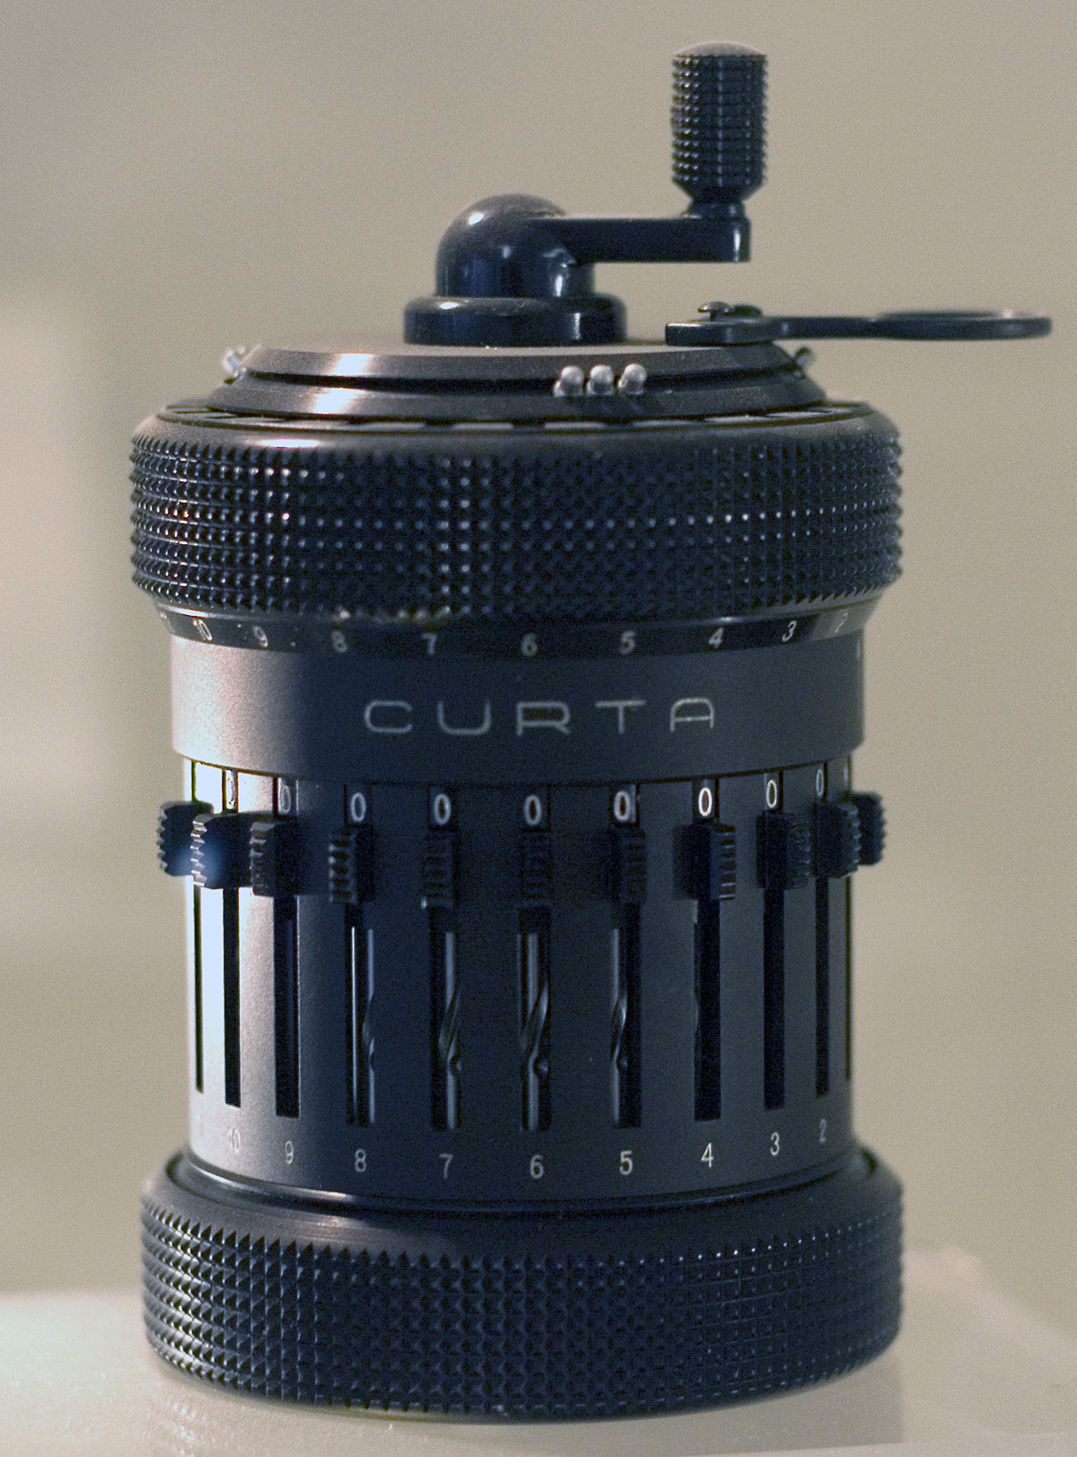
Iteration
With larger numbers and addition with carry as something that can work, the move is to "iterate"
Multiplication is repeated addition. If you have a way to count down form a number, you can add a motor or crank to automate multiplication.
https://en.wikipedia.org/wiki/Mechanical_computer

Slide 19
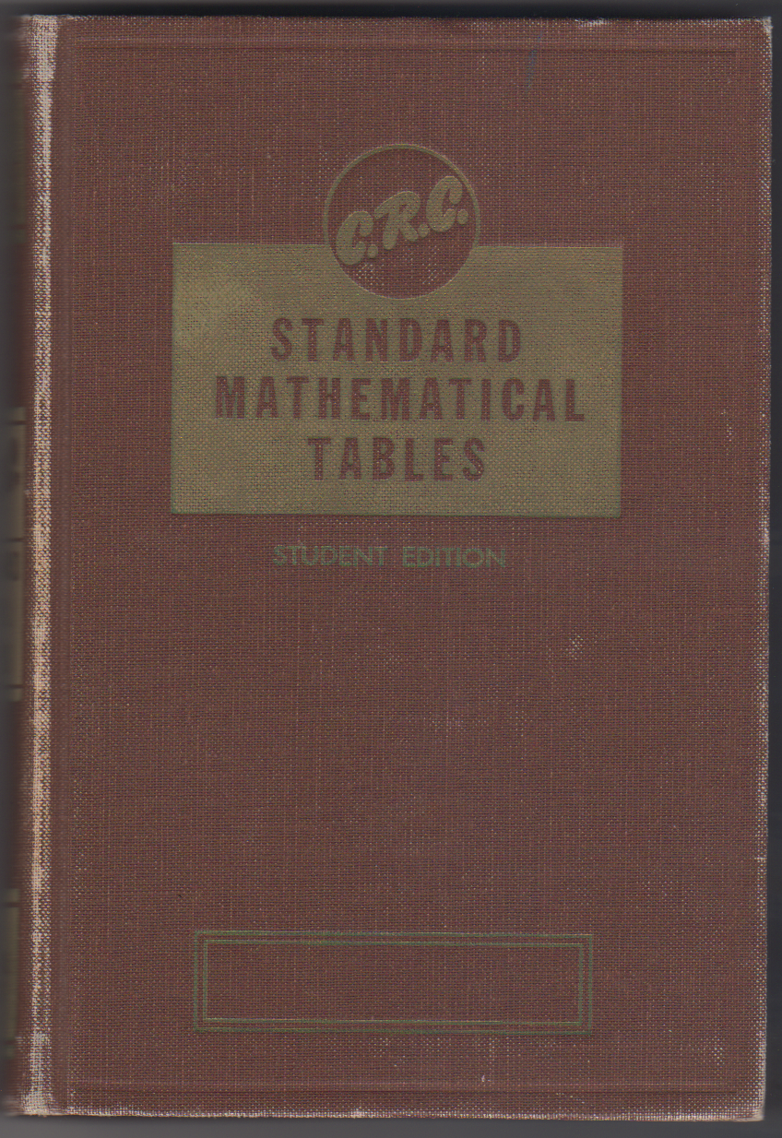
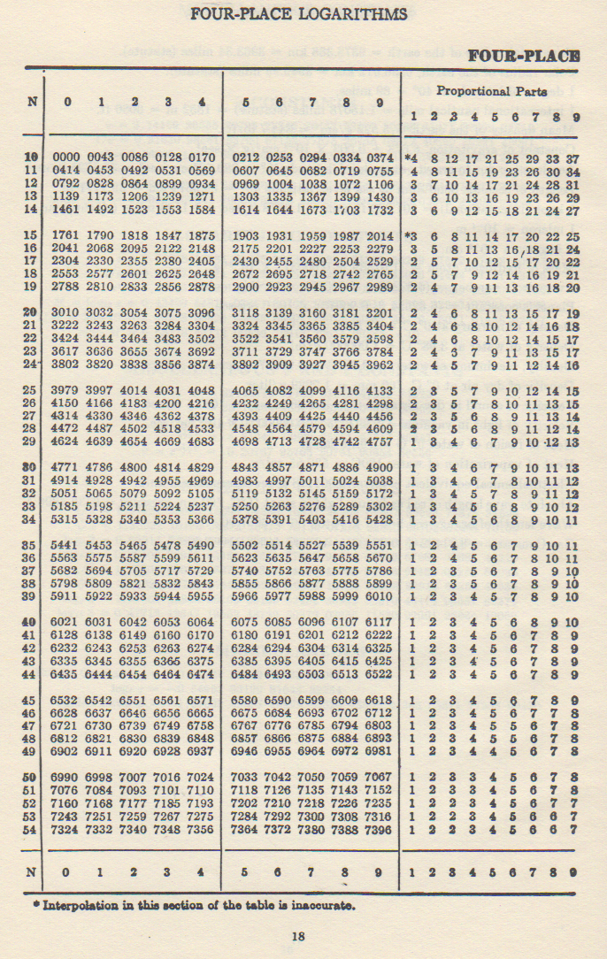
Before Scientific Calculators
For more complex math like trigonometry and logarithms we often used books with tables of numbers.

Slide 20
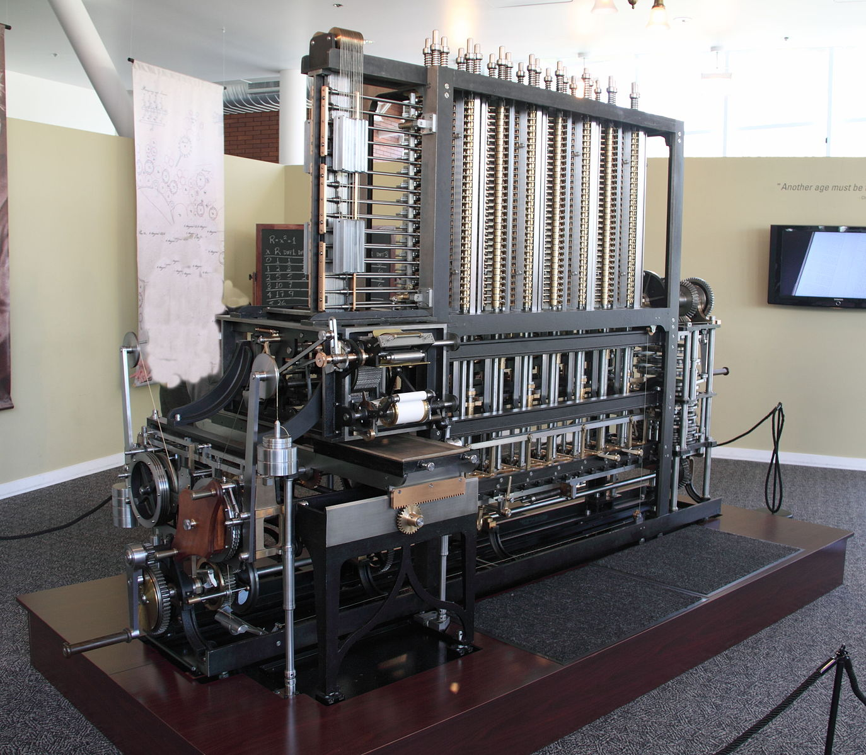
Babbage Difference Engine
www.ca4e.com/ref
In the 1820's Charles Babbage designed a mechanical calculator to compute up to seventh order polynomials
It could produce tables of advanced functions using polynomial approximation
Babbage built a small prototype in the 1800's by full scale system was not built until 1991 – and it worked!
https://en.wikipedia.org/wiki/Difference_engine

